Slide 1

Using Big Data To Solve
Economic and Social Problems
Professor Raj Chetty
Head Section Leader Rebecca Toseland
Photo Credit: Florida Atlantic University

Slide 2
Forecasting Flu Outbreaks Using Google Search Data
Data to be predicted: 1,152 observations from CDC on flu incidence
  Weekly data from 9 regions of the U.S. from 2004-2007
Data used for prediction: counts of Google search data
  Weekly data on Google search counts for 50 million terms by state from 2004-2007

Slide 3
Google Flu Trends: Overfitting Problem
This is an example of “wide data”
  Many more variables than number of observations
  Overfitting problem: can fit the data perfectly using 1,152 explanatory variables → cannot use traditional statistical methods like regression
Solve this problem using out-of-sample validation
  Idea: use separate samples to estimate the model and evaluate its predictive accuracy

Slide 4
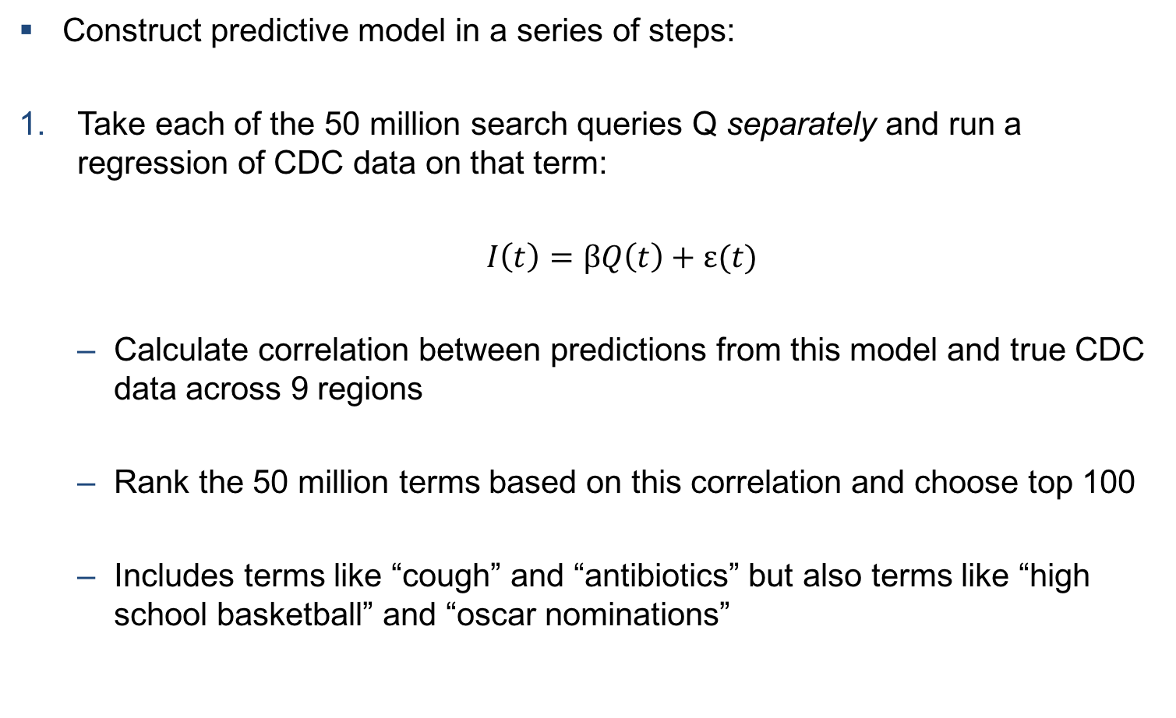
Google Flu Trends: Methodology
Construct predictive model in a series of steps:
Take each of the 50 million search queries Q separately and run a regression of CDC data on that term:
    $I\left(t\right)=βQ\left(t\right)+ε(t)$
  Calculate correlation between predictions from this model and true CDC data across 9 regions
  Rank the 50 million terms based on this correlation and choose top 100
  Includes terms like “cough” and “antibiotics” but also terms like “high school basketball” and “oscar nominations”

Slide 5
Google Flu Trends: Methodology
Construct predictive model in a series of steps:
Using a separate set of data from later weeks to decide which of the top 100 terms to include in prediction model
  Construct sum of search queries across top n terms
  Evaluate how well this sum predicts regional and weekly variation in new sample, varying n from 1 to 100

Slide 6
Out of Sample Validation to Choose Optimal Number of Search Queries
oscar
nominations

Slide 7
Google Flu Trends: Methodology
Construct predictive model in a series of steps:
Finally, evaluate model fit and out of sample predictive accuracy using subsequent data that was not available when model was estimated

Slide 8
In-Sample and Out-of-Sample Fit of Prediction Model
Out-of-sample
Validation
Note: CDC official statistics in red; Google trends forecast in black

Slide 9
Out-of-Sample Model Validation Using Two-Week Lead Time
Note: CDC official statistics in red; Google trends forecast in black

Slide 10
Breakdown of Google Flu Trends Predictive Model
Problem: predictive model began to break down in late 2012 and became very inaccurate in forecasting outbreaks of flu
Lazer et al. (2014) document model’s failure essentially by extending window used for out of sample to 2013

Slide 11
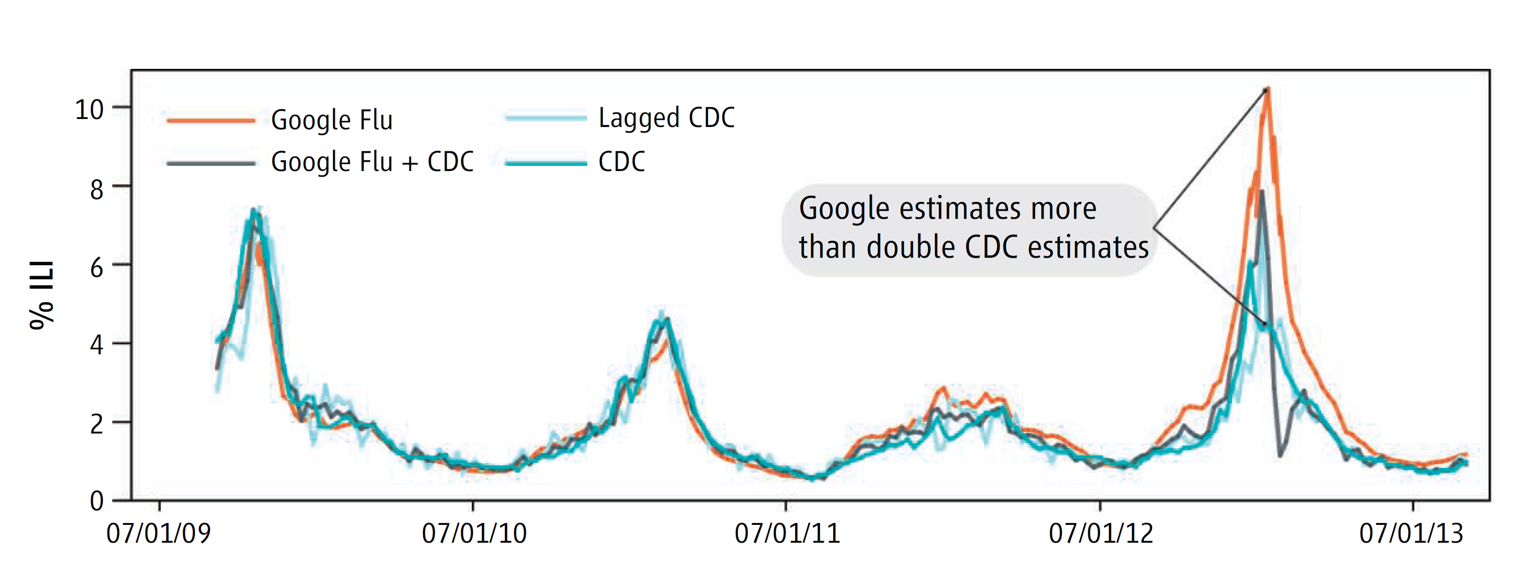
Out-of-Sample Fit of Prediction Model

Slide 12
Breakdown of Google Flu Trends Predictive Model
Problem: predictive model started to break down over time and became very inaccurate
Lazer et al. (2014) document this breakdown essentially by extending window used for out of sample to 2013
Why did the model start to perform poorly?
  Google search engine started to prompt users to search for additional diagnoses after entering a term like fever or cough
  Autofill started to offer suggestions for search terms
  Both of these factors changed nature of search queries; since model was not re-estimated, predictions changed

Slide 13
Broader Lessons from Google Flu Predictive Model
Big data has great potential for predictive modeling with applications to social problems
  Ginsberg et al. (2009) became the basis for Google Correlate, a public tool to find searches that correlate with real-world data

Slide 14
Broader Lessons from Google Flu Predictive Model
Big data has great potential for predictive modeling with applications to social problems
But big data is not a substitute for ground truth
  Good thing that CDC did not abandon its program to collect data on flu incidence from clinics after Ginsberg et al. (2009) was published

Slide 15
Broader Lessons from Google Flu Predictive Model
Big data has great potential for predictive modeling with applications to social problems
But big data is not a substitute for ground truth
Building good models requires both technical skill and careful judgement
  Fitting black-box models is tempting, but models where mechanisms are sensible are more likely to yield stable predictions
  When terms like “oscar nominations” show up, should be very cautious
  Frontier of research in machine learning: developing tools to improve predictive accuracy in such settings

Slide 16
The Economics of Health Care

Slide 17
The Economics of Health Care
Health economists focus on studying markets for health care
  Why is health care so expensive in the United States?
  Will expanding health insurance coverage improve health outcomes or just lead to more wasteful spending?
  How can we provide health insurance to more Americans?

Slide 18
Dartmouth Atlas: Geographic Variation in Health Spending
Dartmouth Atlas uses data from Medicare claims to calculate expenditures per adult in local areas
  Adjust for differences in population demographics (race, sex, age)
Substantial spatial variation in health care expenditures that is driven by variation in quantity of care
  Medicare expenditures vary from $8,300 to $10,400 per person between 20th and 80th percentile across areas in the U.S.

Slide 19
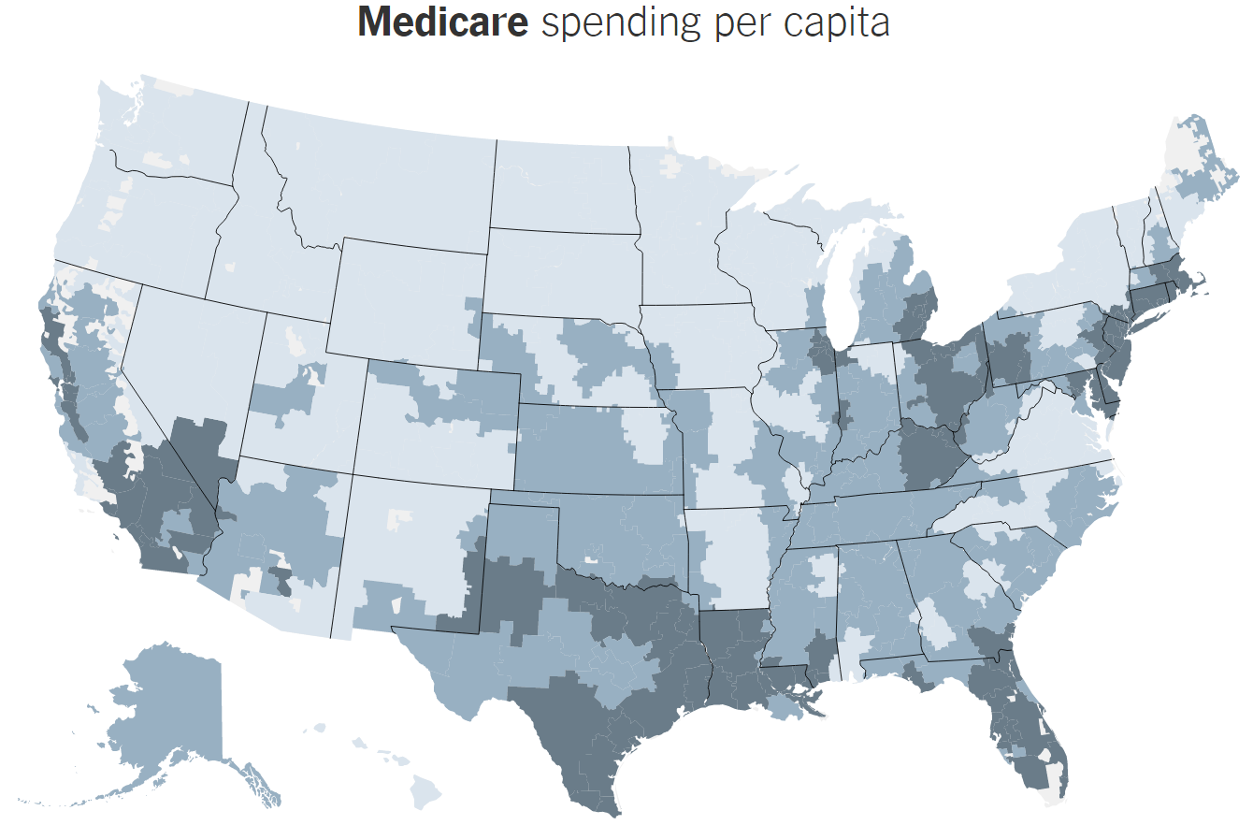
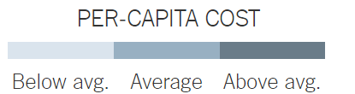
Notes:
19

Slide 20
Geographical Variation in Rates of Knee Replacements
Salt Lake City, UT
Des Moines, IA
Columbus, OH
Philadelphia, PA
Houston, TX
Manhattan, NY
4
6
8
10
12
14
Inpatient Knee Replacement Rate per 1000 Medicare Enrollees
Notes:
20

Slide 21
Dartmouth Atlas: Geographic Variation in Health Spending
Expenditures not correlated with health outcomes
  Led to concern about “flat of the curve” medicine, particularly after a widely-read article by Atul Gawande in 2009
  Physicians and hospitals compensated by government for non-essential procedures (e.g., MRIs) → concern about wasteful spending
  Motivated efforts to reduce expenditures in areas such as McAllen, TX
  But implications heavily debated: is there really wasteful spending or is it just that patient populations differ across places (selection effects)?

Slide 22
Geographic Variation: Private Health Insurers
Dartmouth Atlas only had data from Medicare, not from private insurance companies (below age 65)
Cooper et al. (2015) show that there is substantial variation in private insurer expenditures as well
  Expenditures vary from $3,000 to $3,900 between 20th and 80th percentile across areas
But geographic pattern is very different for private health insurers

Slide 23
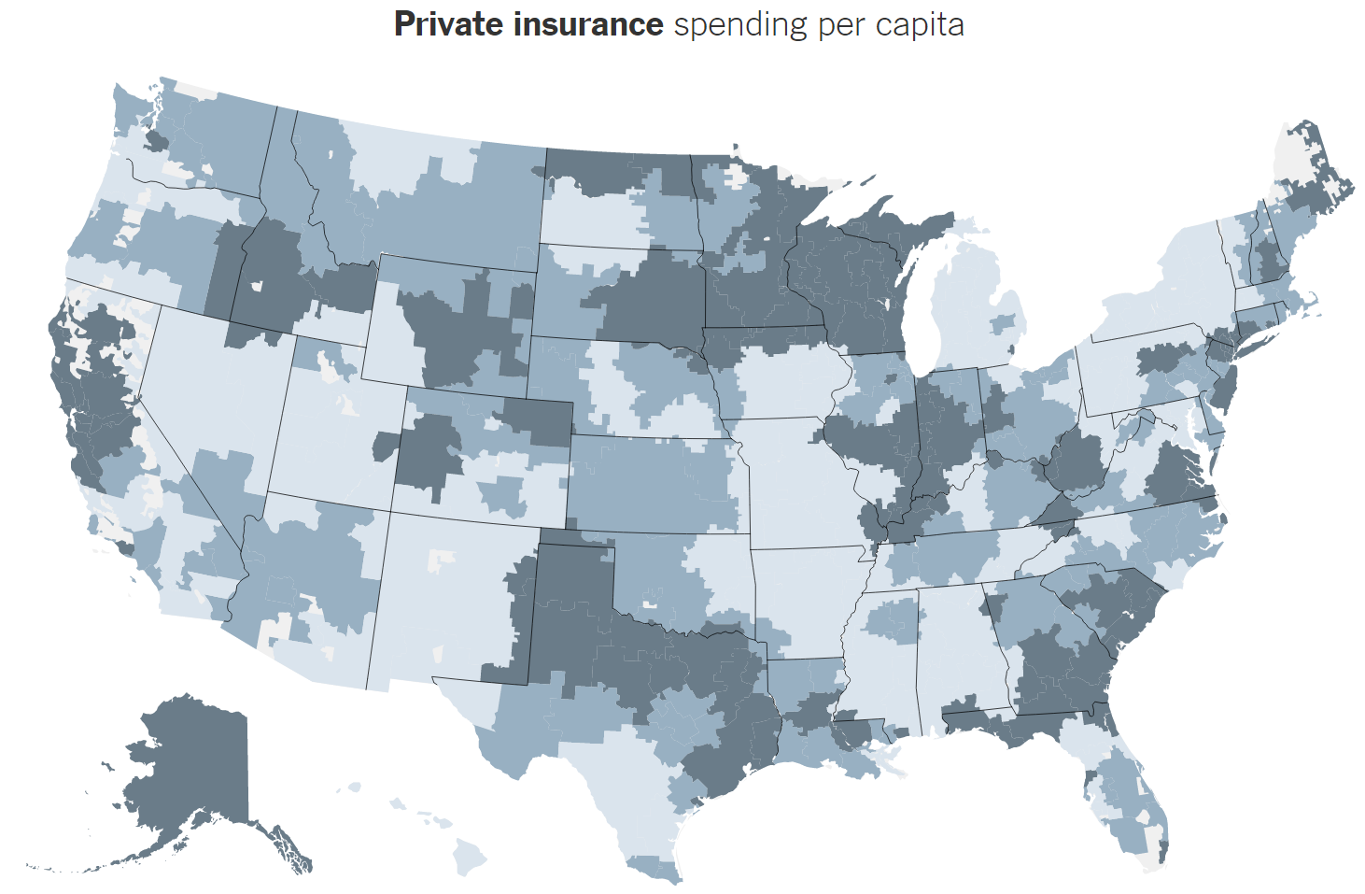
Notes:
23

Slide 24
Geographic Variation: Private Health Insurers
Dartmouth Atlas only had data from Medicare, not from private insurance companies (below age 65)
Cooper et al. (2015) show that a very different picture emerges for private health insurers
  Correlation between private health insurance expenditures and Medicare expenditures is only 0.14 across areas
  And most of the variation is due to prices, not quantities…

Slide 25
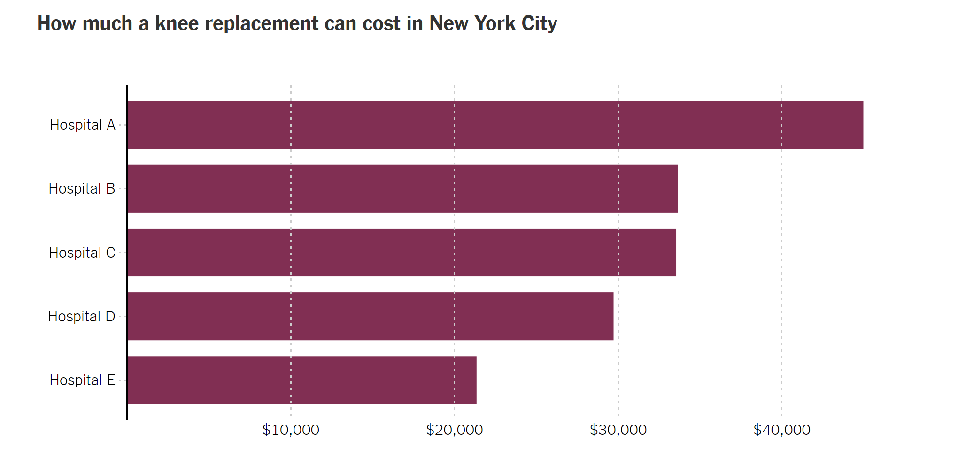
Notes:
25

Slide 26
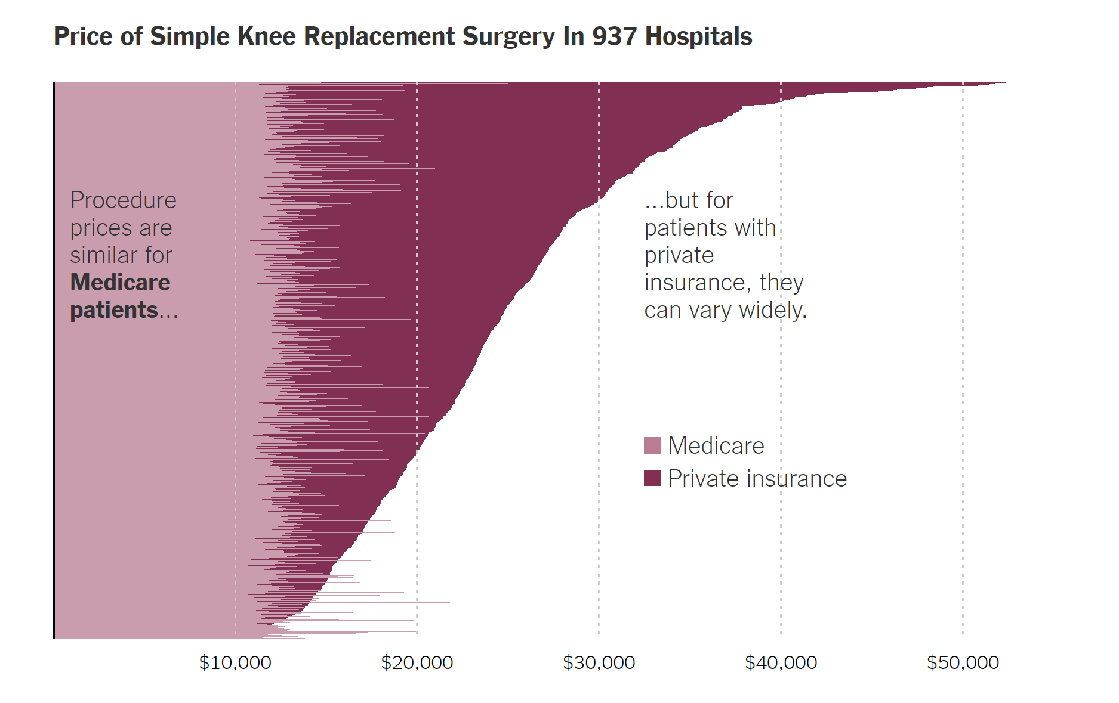
Notes:
26

Slide 27
Lessons from Geographic Variation on Efficiency of Markets for Health Care
Health care markets function very differently from markets for other goods such as cars or cell phones
Wide variation in prices and quantities for what appear to be similar services suggests that there may be considerable inefficiency
Many factors at play, but one important and unique feature: third-party (insurance company or Medicare) payment
  Customer is not paying the price → may be little incentive to find the cheapest price and little incentive to cut back on quantity

Slide 28
Insurance and Demand for Health Care
What is the causal effect of insurance on demand for health care and health outcomes?
  Does providing individuals’ insurance actually encourage wasteful spending or does it improve health outcomes?
Ideal experiment: randomly assign health insurance to some individuals and not others and compare outcomes
This turns out to be a rare case where we actually have such an experiment

Slide 29
Oregon Health Insurance Experiment
In 2008, Oregon had capacity to expand Medicaid insurance coverage to individuals between ages 19-64
Anticipated that budget would not cover all individuals who would want insurance → offered insurance through a randomized lottery
  Treatment group: 30K individuals who received insurance
  Control group: 45K individuals who did not
Evaluate impacts using administrative data from Medicaid and hospitals as well as follow-up surveys
Series of papers by Baicker, Finkelstein, and co-authors

Slide 30
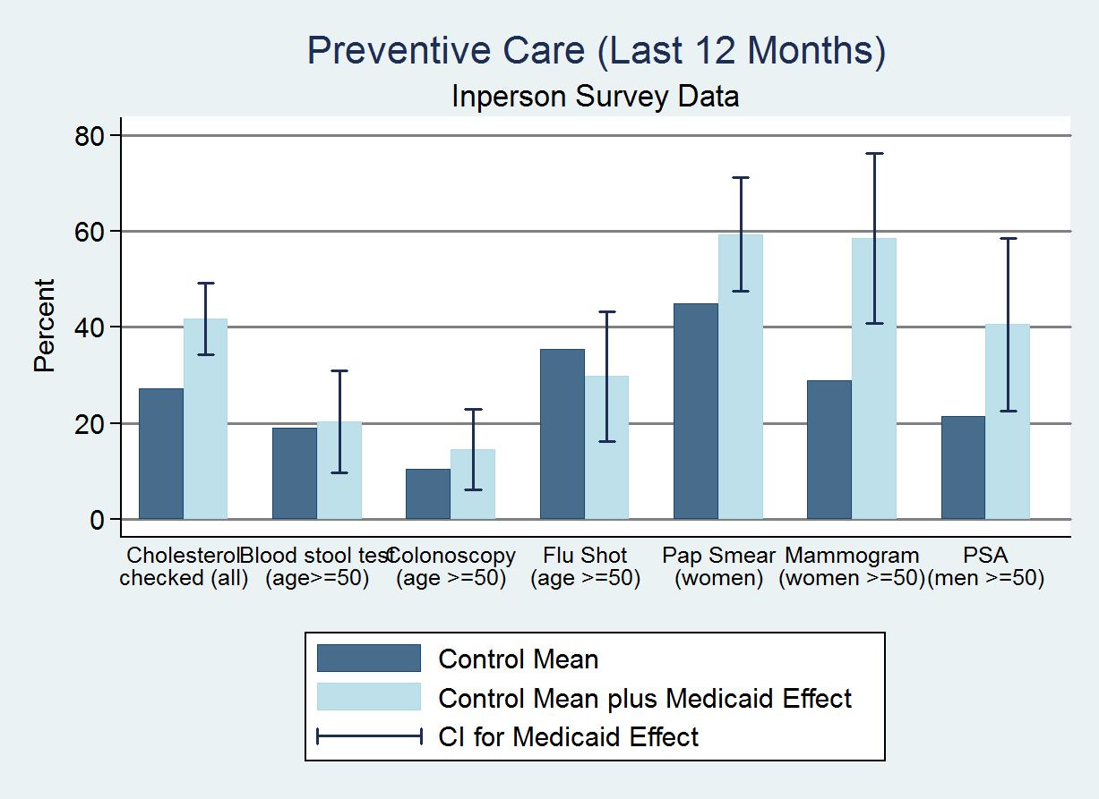
Cholesterol checked (all)
Blood stool test (age>=50)
Colonoscopy (age>=50)
Flu Shot
(age>=50)
Pap Smear
(women)
Mammogram
(women>=50)
PSA
(men>=50)

Slide 31
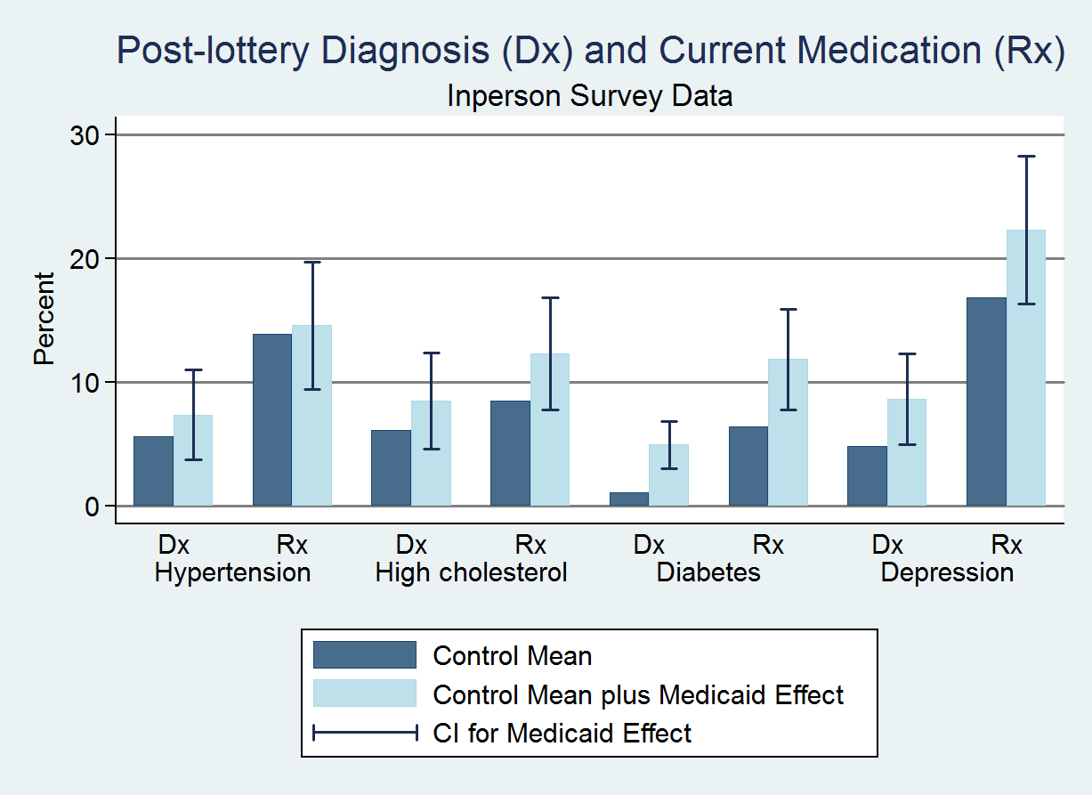

Slide 32
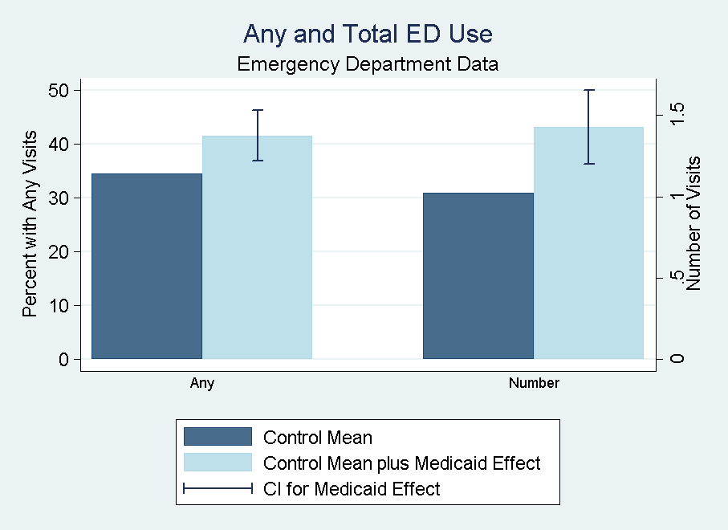

Slide 33
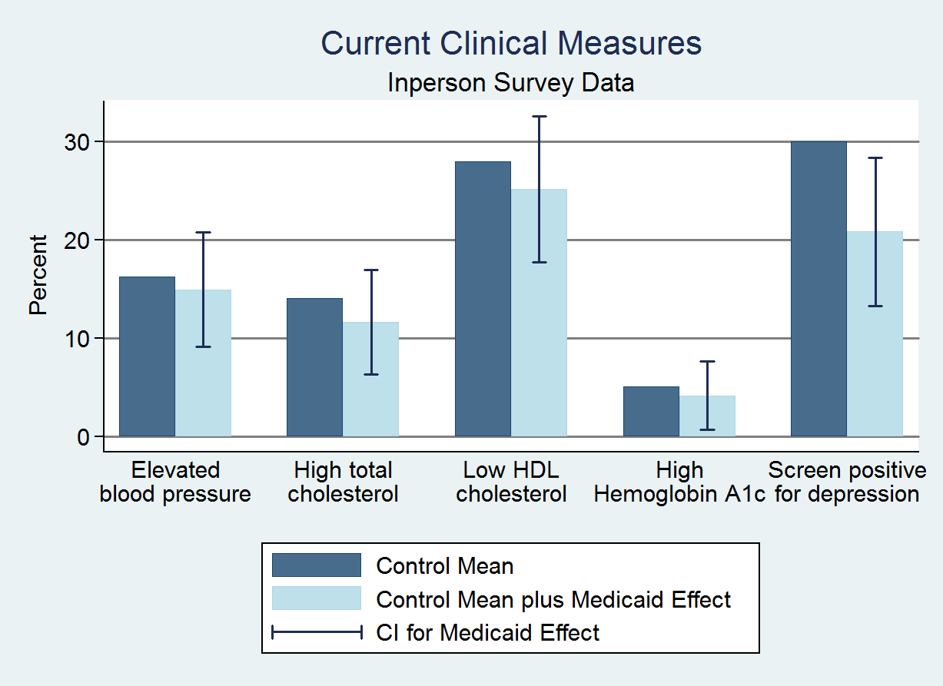

Slide 34
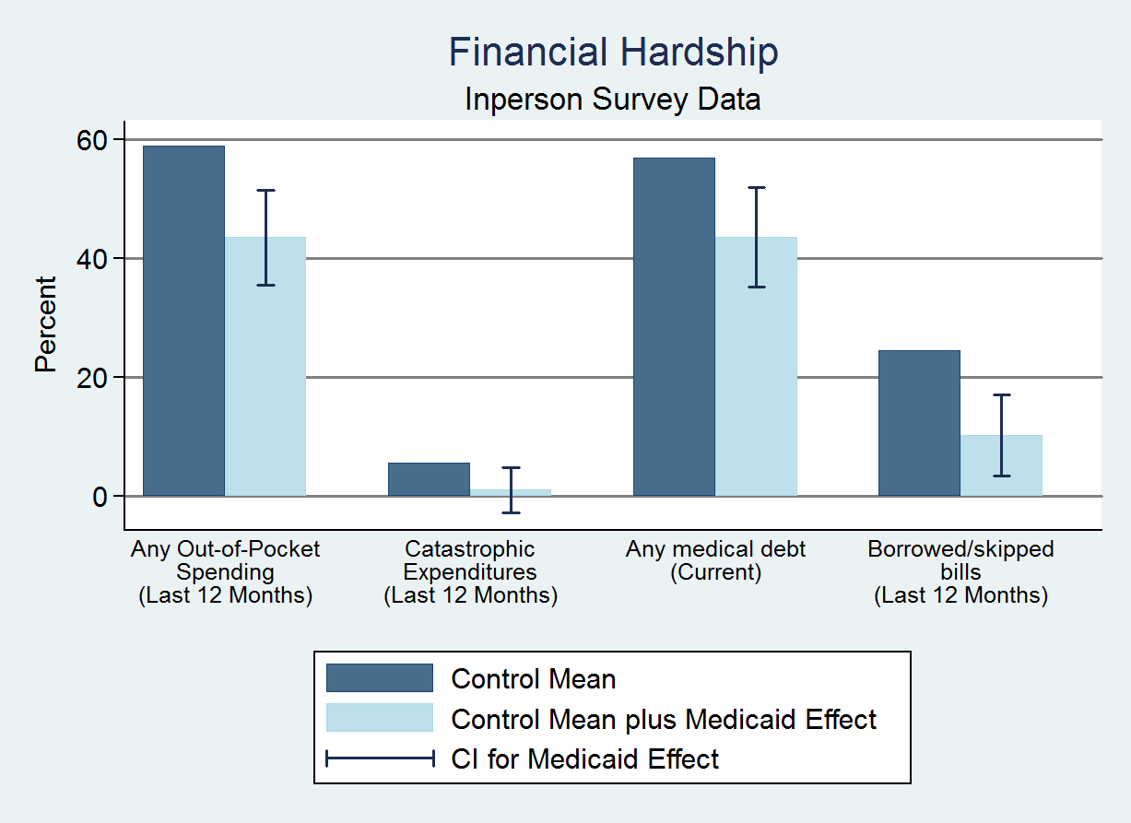

Slide 35
Oregon Health Insurance Experiment: Lessons
Insurance coverage increases utilization of health care moderately
Insurance coverage improves self-reported health and reduces clinical depression
  Insufficient statistical power to detect effects on physical measures of health
Insurance coverage significantly reduces financial hardship

Slide 36
Oregon Health Insurance Experiment: Lessons
Experimental data do not support view that insurance itself leads to substantial “wasteful spending” on health care
Suggests that broader systemic differences may be more important, such as:
  Differences in physicians’ practice styles across areas
  Defensive medicine to protect against lawsuits
  Monopoly power of hospitals → high prices in some areas
  [Cooper et al. 2015]

Slide 37
Long-Term Impacts of Health Insurance
Oregon experiment evaluates immediate impact of health insurance
As with earnings, plausible that health impacts show up with a delay
Does providing Medicaid to children improve long-term outcomes and lower long-run costs (e.g., by reducing hospitalizations)?

Slide 38
Effects of Childhood Medicaid Coverage
on Health Care Use and Outcomes in Adulthood
Wherry and Meyer (2015) and Wherry et al. (2017) study these questions using a regression discontinuity design
  Medicaid eligibility was expanded for children in low-income families born after September 30, 1983
Data: discharge-level hospital data and outpatient emergency department visits in California, Texas, New York, and other states
  No data on income → compare black vs. white children instead

Slide 39
Fraction of Children with Medicaid Coverage Between the Ages of 8 and 13, by Birth Month

Slide 40
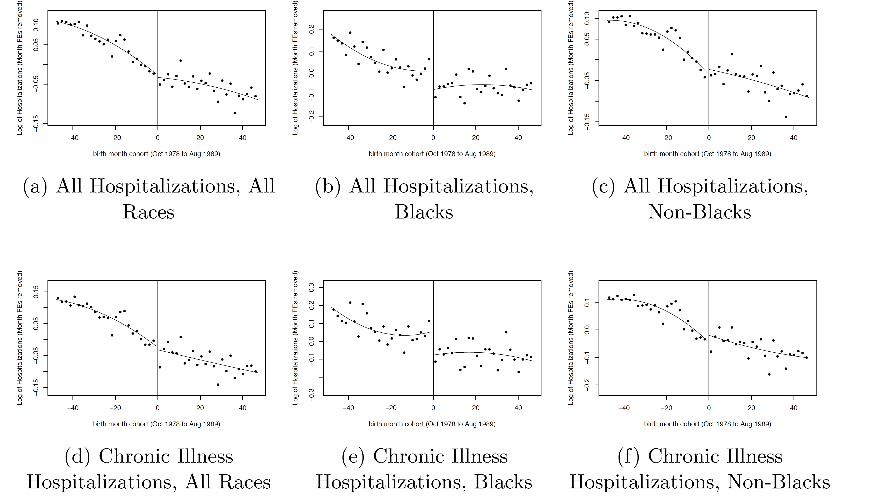
Hospitalizations in 2009 (mid 20s) by Month of Birth

Slide 41
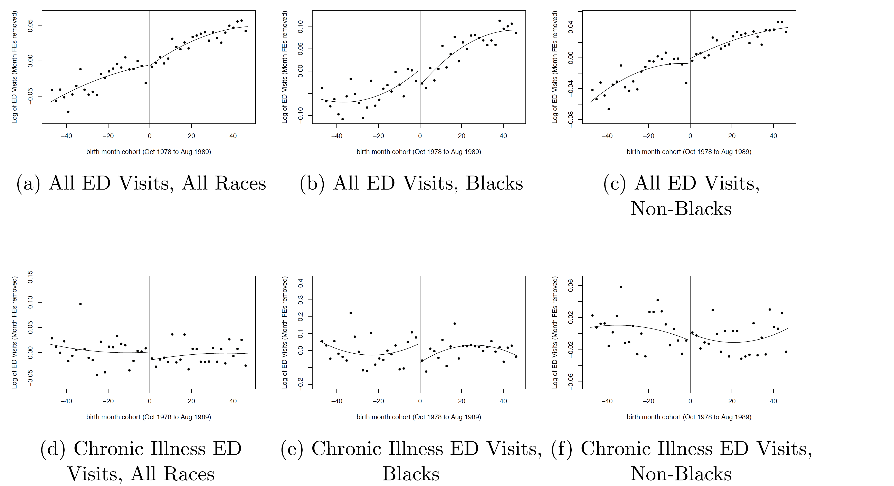
Emergency Department Visits in 2009 (mid 20s) by Month of Birth

Slide 42
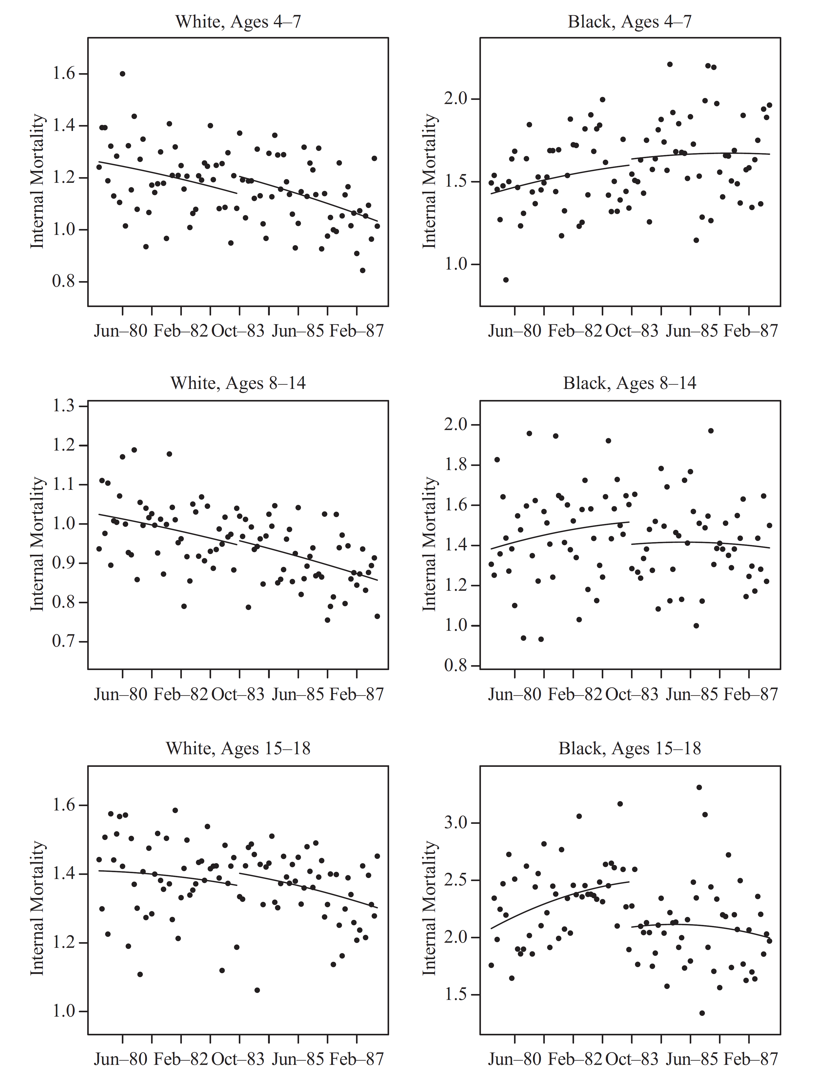
Mortality Rates
by Month of Birth:
Internal Causes

Slide 43
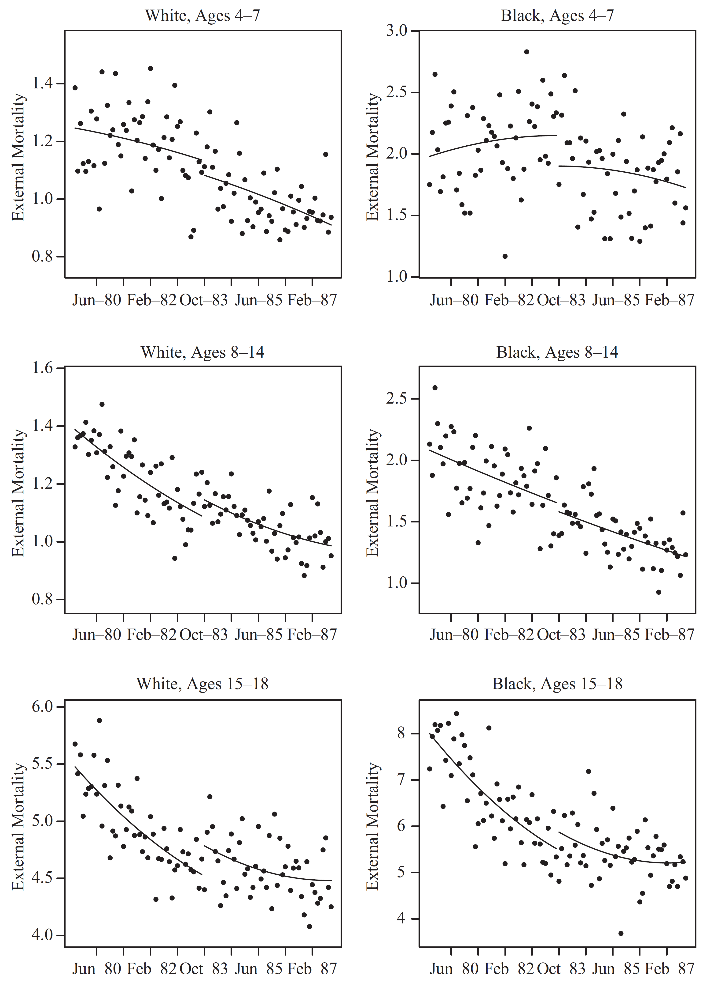
Mortality Rates
by Month of Birth:
External Causes

Slide 44
Government Intervention in Markets for Health Insurance
Data show that insurance coverage leads to moderate increases in health care use and improvement in health outcomes
Suggests that access to health insurance can be valuable for improving population health
But does not necessarily follow that government needs to provide this insurance
  Why can’t people buy it themselves in private markets, like they do other products like cars?

Slide 45
Summary: Health Care and Insurance in the U.S.
Insurance matters for health outcomes and financial security
Difficult to sustain markets for insurance without government insurance or direct government provision (single payer system)
Insurance contributes modestly to higher costs
  But reasons that health care costs are so high and so variable in the U.S. remain unclear

Slide 46
Summary: Health Care and Insurance in the U.S.
Better data are likely to help in terms of answering this question and increasing accountability
  Currently, prices are not even clear to patients and providers → little pressure to reduce or even monitor costs for any party

